Slide 1
Harmonographs and the ElectroHarmonograph
Frank Palazzolo
frank@avoidspikes.com
Detroit Physics Meetup
Monday. August 3rd, 2015

Slide 2
Something For Everyone
History
Physics
Math
Engineering

Slide 3
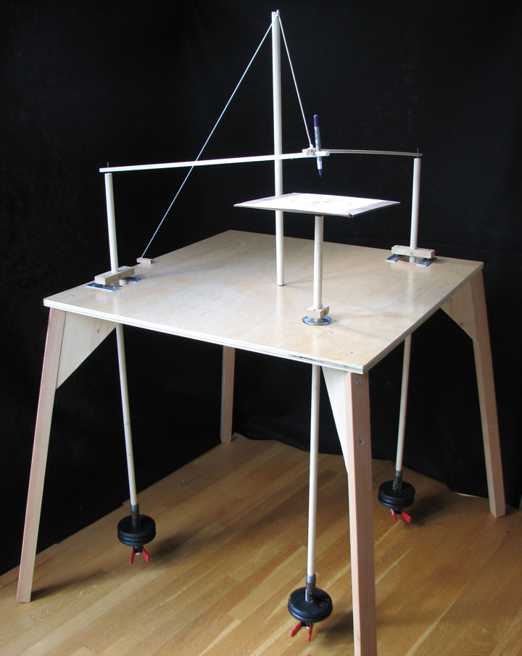
What is a Harmonograph?
19th Century “Parlor Game”
Automatic drawing machine, based on the motion of pendulums
Patterns are similar to a “Spirograph” toy
Variation in pictures comes from:
  Different physical parameters (Pendulum Length, etc.)
  Different initial conditions (Start Position)

Slide 4
Harmonograph Links
Book:
  http://www.amazon.com/s/ref=nb_sb_noss_1?url=search-alias%3Daps&field-keywords=harmonograph
Videos:
  https://www.youtube.com/watch?v=bXAWXoew9mM
Samples:
  https://www.google.com/imghp?hl=en&q=harmonograph+drawing

Slide 5
How It Works
2-Pendulum and 3-Pendulum varieties
Two pendulums control X and Y displacement of a pen
Third pendulum (Rotary) controls a movable writing platform.

Slide 6
What’s in a name?
Name comes from it’s relation to music
Simple mathematical relations between pendulum lengths lead to nice symmetric patterns (Harmonies!) just like musical notes
Other relations lead to discord / chaotic looking pictures

Slide 7
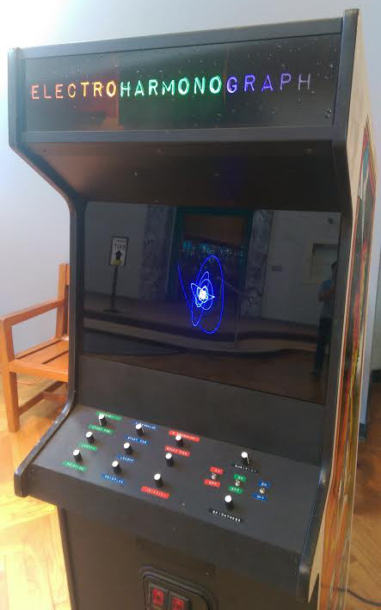
The ElectroHarmonograph
Idea: Could I make an electronic version of a Harmonograph?
Electrical circuit could mimic the pendulum motions.
Real-time display of the results
Knobs to change the “Pendulum” parameters
Already seen simulators, wanted something physical

Slide 8
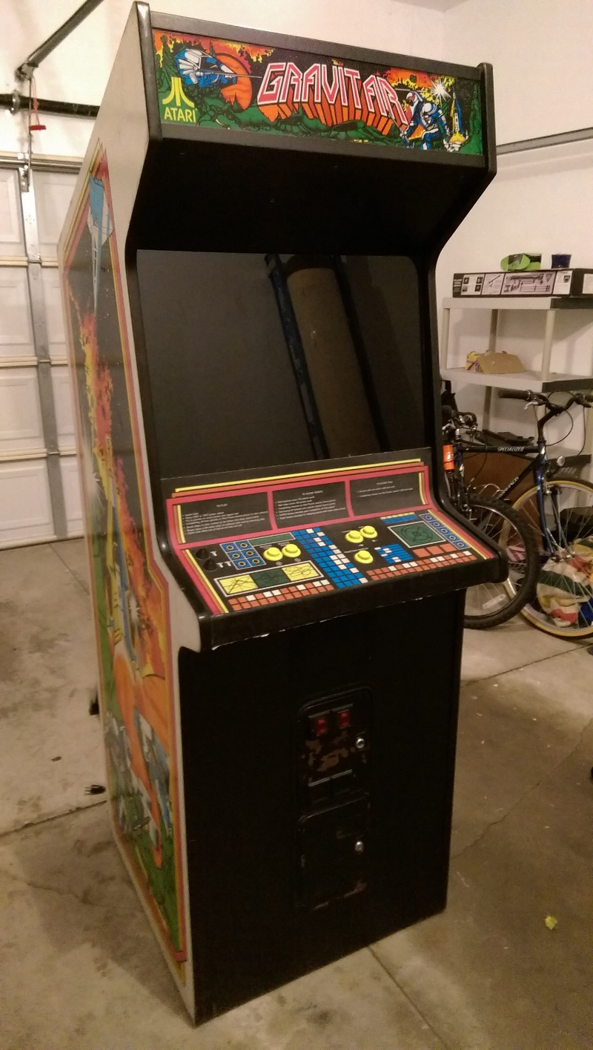
80’s Coin-Operated Arcade Games
Big Cabinets
Control Panel
Cathode-Ray Tube (CRT) Monitors
  Raster vs Vector Monitors

Slide 9
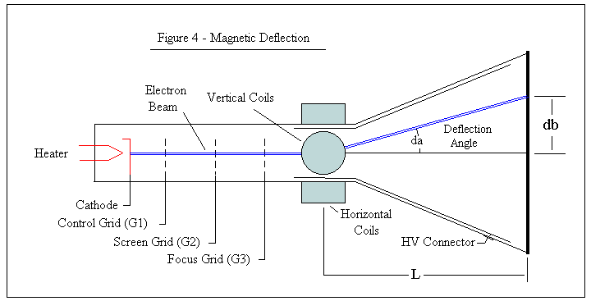
Cathode Ray Tubes
Vacuum tube (Picture Tube)
Electron gun (source of electrons)
Phosphor-coated screen change electrons into light
Magnetic Coils used to deflect electron beam

Slide 10
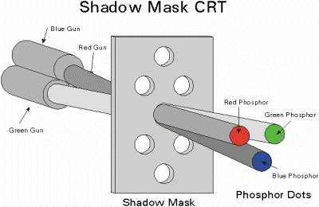
Color vs Black & White
Color Monitor has 3 electron guns
Shadow Mask
3 phosphors (Red, Green, Blue)

Slide 11
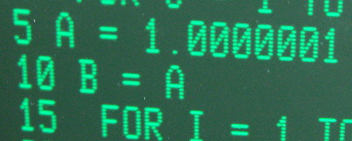
Raster Monitor (Old TV tech)
Horizontal and Vertical Deflection is fixed
Screen data is “painted on top to bottom, left to right”
Beam is “blanked” while retracing from bottom to top

Slide 12

Vector Monitor (Special)
Beam can directly be control via X and Y voltages.
Beam brightness is related to intensity of the beam, and the velocity of the beam
Not used for curved lines
Very Black background
Only popular for a short time – late 70’s to mid 80’s
Need to Use This!

Slide 13
How to generate the X and Y signals
Could use a digital computer board (Raspberry PI, BeagleBoard), with X and Y out (analog voltage out). Mostly a software project.
Could build raw circuits which generate the necessary X and Y waveforms (analog)
This is basically an Analog Computer

Slide 14
Analog Computers
“Analog” as in “not Digital”
  Analog: can take on a range of values (continuous)
  Digital: can take on a fixed set of values (discrete)
“Analogue” as in “analogy” or “analogous”
Analog Computers don’t “compute”, they just “act”
Circuit made of Amplifiers and Switches which is the electrical analogue of a pendulum system (acts the same)

Slide 15
Simple (1D) Pendulum Physics
Energy transfer from Kinetic to Potential over time
Energy decays over time due to friction
Energy Equation (Hamiltonian)
  Kinetic is based on speed
  Potential is based on position
Linear Simplification (small deflection)

Slide 16
Simple (1D) Pendulum Physics – cont’d
Equation of Motion
“Simple Harmonic Oscillator with Damping”
Direct Solution is possible

Slide 17
“Spherical” Pendulum (2D) Physics
See Paper
  https://www.physicsforums.com/attachments/deriving-the-eqns-of-motion_second-approach-3d-pdf.47912/
  Trig functions
  Cross terms (x times y)

Slide 18
How To Drive a Vector Monitor
1) Turn Beam Off while moving circuit to initial conditions (Retrace!)
2) Turn Beam On and let the circuit run for a while (Draw!)
3) Repeat!
Shouldn’t leave the beam in one spot to long – will burn hole in the phosphor!
  Atari – Spot killer circuit should help with this

Slide 19
Pendulum circuit – building blocks
Op-Amps (Operational Amplifiers)
  Voltage is the independent variable
  Can act as an integrator, gain, inverter, sum
  No multiply, complex functions
Analog Switch
  Connect/Disconnect circuits on demand

Slide 20
1D Pendulum Circuit
Simple Harmonic Oscillator with Damping
2 Capacitors – energy storage devices
  Kinetic Energy / Speed / Initial Condition
  Potential Energy / Position / Initial Condition
Adjust Voltage for Initial Condition (Position)
Adjust Resistor for Frequency (Pendulum Length)
Adjust Resistor for Damping (Friction)
3 Op-Amps + 2 Analog Switches, 1 More Op-Amp for Initial Conditions

Slide 21
Rotary Pendulum Circuit
Uh-oh – too hard to do correctly without Analog Multipliers, at least…
Wait – let’s try another 1D oscillator
  Use Position as X
  Use Speed as Y
  Already 90 degrees out of phase
Circular Motion at a given frequency
“Elliptical” Motion above or below that frequency
Good Enough!

Slide 22
Other Circuit Design
Power Regulator
3 Pendulum Oscillators
Summers for X and Y
Oscillator for Draw/Retrace (Duration Knob)
Brightness adjusts
Color-Enable Switches

Slide 23
Development Process
Repair Game
Prototype Rotary Oscillator
Build/Debug rest of the circuit
Physical Design/Construction and Assembly
<2 Months
Last wiring error fixed 3:00AM day of Maker Faire!!!

Slide 24
The Result
Pretty Dang Cool!!!
Some unexpected effects
  Clipping/Jumping behavior
  Non-Physical parameter ranges
    Pendulum too short
    Friction too low
  Very 3D-like effects!!
  More Friction than expected

Slide 25
Next Time…?
Do A PCB!!!
Digital Version???
More Gain?
Modulate Colors?
Sound?
Better handling of control ranges?

