Slide 1
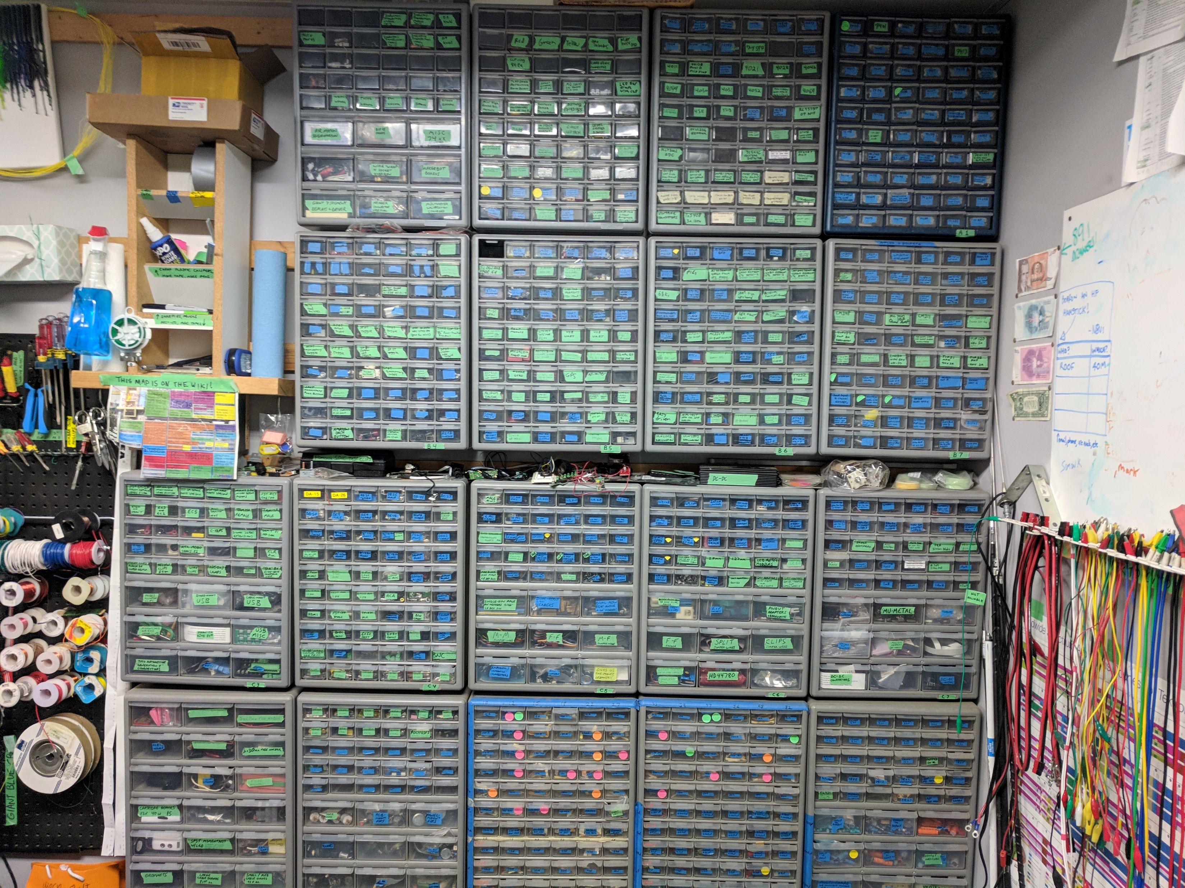
Transformers, Inductors, Big Knobs
LED’s (Red, Green, Yellow), Gas Sensors, Rotary Encoders,
CMOS ICs and Op-Amps
7400 series ICs, Op-Amps
Misc
Banana Connectors
DC Motors, FM Stereo Receivers
Transistors:
MOSFETS’s, Vintage….
Drivers, Makerbot Board, Motion Sensor, Sockets
Tyco Connectors
Tyco Contacts
LED peripherals
Machine Screws, Lock Washers
Switches:
Pushbutton, Slide, Toggle, lever, key DIP, PCB-mount, panel-mount, lighted, momentary, alternate-action, you name it…
LED’s
PIC & AVR Microcontrollers
Op-Amps
Communication Devices (Tx/Rx, USB UART), Gear motors
Peripherlas:
RAM, Flash, RTC’s, Video Boards
Audio Amplifiers
Sensors:
GPS, Gyro, Barometer, Accelerometer,
Current, Hall-effect, IR, Therm
Transistors:
BJT’s, UJT’s, MOSFETS’s, JFET’s….
Motor driver chips
Misc Connectors, Clips, Lamps
DB Connectors,
D-sub connectors
Ribbons
Diodes, non-LED,
Inductors,
Bridge rectefiers
Plugs and jacks for:
Barrel (DC Power),
TRS (headphone),
OBD2 (car diag.),
Banana and binding posts, pogo pins, BNC jacks
Stacking header, Deep Socket
SMT Adapters, LCD, oLED
USB’s,
Alligator Clips,
Tyco Automotive “Generation Y” Connectors
1 & 2-row male pin headers,
Jumper Wires
Jumper wires,
Servos,
Pinout Adapters & Breakouts
Mu-Metal
Crystals & Resonators
Misc Connectors
$MONEY$
DC to DC Converters
Fuses
Toggle, misc
Fuse Holders
Resistors
E12 value series from 10 ohms to 1M
Zener diodes,
Voltage references,
78xx linear V.reg,
SMPS ctrl IC’s
Trimpots,
Panel-mount pots
Cartridge Heater,
Gronmets
Batt. Charger,
Cable Glands
Meg-plus, sub-10ohm
Capacitors 1nF-68µF
Capacitors 100µF-10,000µF
Capacitors 1pF-680pF
Resistors

